Slide 1

Team Members: CHTYVE001 - Yvershen Chetty
GYRADI001 – Adiel Geyer
HCTGER001 - Gerald Hector
KWTOLE001 - Olesedi Kwetsi
SLSEDW001 – Edwin Saulse
SLSHAF001 - Hafiz Salasa
SSMWIL002 - Wilson Sisimi
Group 7:
Vulnerability Management Prioritisation Best Practices

Slide 2
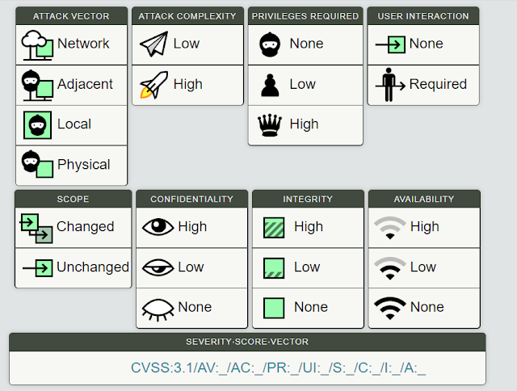
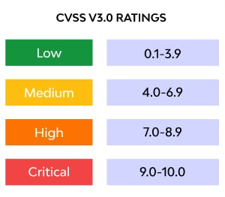
Introduction
The Common Vulnerability Scoring System (CVSS v3.1) is an open, industry-standard framework used to assess and rate the severity of software vulnerabilities.
Focus: Measures the inherent severity of a vulnerability based on its technical characteristics.
Score: Ranges from 0 to 10, with 0 indicating no impact and 10 representing the most severe.
Purpose: Helps organisations understand the potential impact of a vulnerability on confidentiality, integrity, and availability.
Statistic: The CVSS base score remains constant regardless of whether a vulnerability is actively exploited.
NB: A CVSS metric string, Severity Score Vector is a compact, text-based representation of the specific values assigned to vulnerability metrics

Slide 3
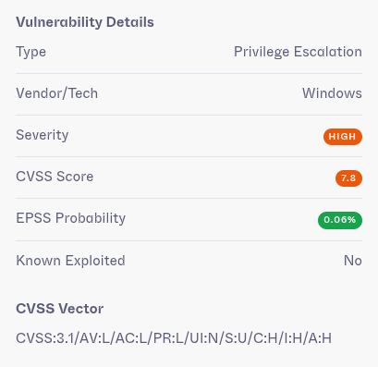

CVE-2026-24294: Windows SMB Server Privilege Escalation
CVE-2026-24294 is an improper authentication vulnerability in Windows SMB Server that allows an authorised attacker to elevate privileges locally. The SMB Server fails to properly validate authentication credentials or session tokens, enabling local users to gain elevated system privileges beyond their authorised access level.​
​
Affected Products ​
Windows SMB Server ​
Windows Operating Systems with SMB Server enabled ​
Microsoft Windows Server and Desktop editions with SMB services​
​
Discovery Timeline ​
March 10, 2026 - CVE-2026-24294 published to NVD ​
Relevance in South Africa
​Window Server Operating Systems are used in most organisations across South Africa. Critical Infrastructure such as Eskom relies on the above-mentioned underlying systems
Immediate Actions ​
Apply the latest Microsoft security updates addressing CVE-2026-24294 as soon as available​
​
Workarounds ​
Disable SMB Server services on systems where the functionality is not required Implement strict network segmentation to limit access to SMB-enabled systems Apply the principle of least privilege to all user accounts with local access

Slide 4
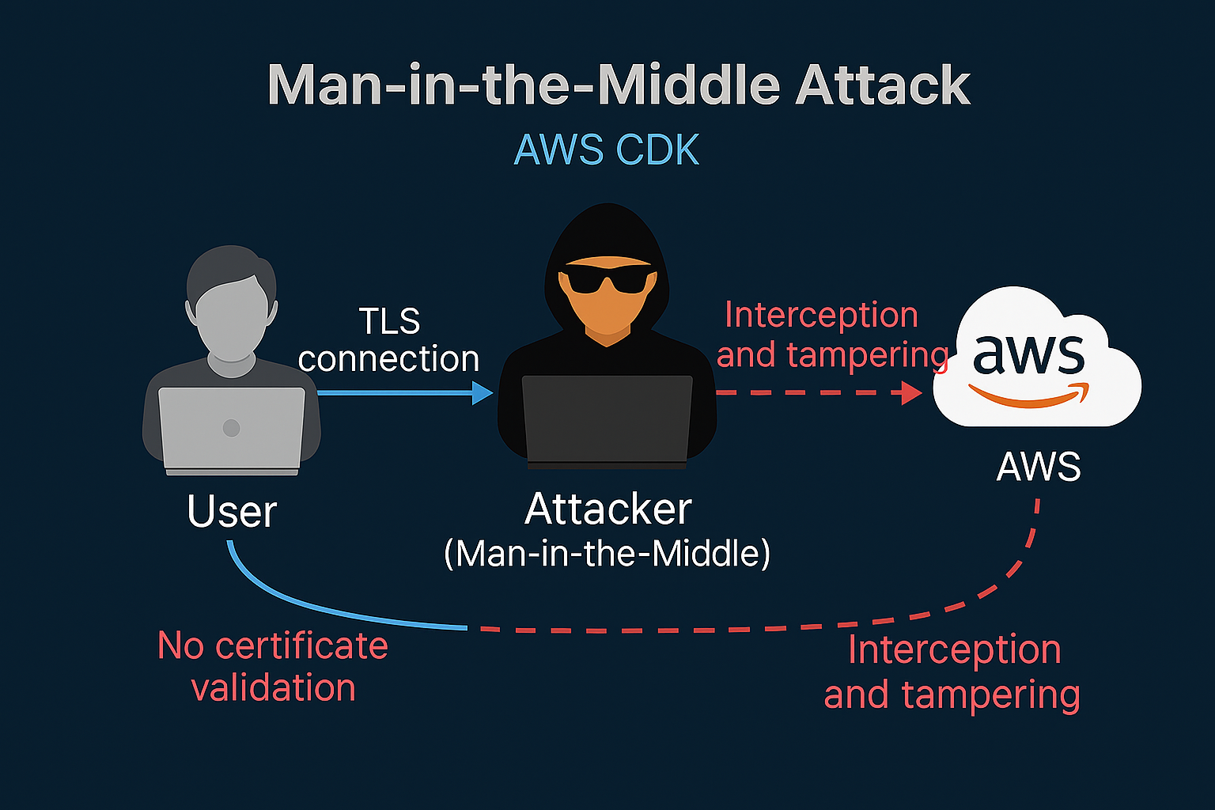
CVE-2025-23206 (AWS-CDK) TLS Certificate Validation Disabled, MITM Risk, and CVSS 8.1 Explained
Vulnerability Overview
CVE‑2025‑23206 disables TLS certificate validation in AWS CDK, creating a risk of man‑in‑the‑middle (MITM) attacks in cloud environments widely used by South African organisations.
CVSS:3.1/AV:N/AC:L/PR:L/UI:N/S:U/C:H/I:H/A:N
Security Impact
Man-in-the-middle attacks can intercept and spoof certificates, compromising authentication trust.
CVSS Score Explanation
The vulnerability scores 8.1 high due to network reachability and high confidentiality and integrity impact.
Recommended Mitigation
Upgrade AWS CDK and enable feature flag to enforce certificate validation and secure deployments.

Slide 5

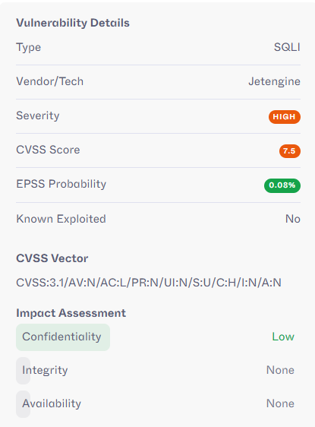
CVE-2026-4662: JetEngine WordPress Plugin SQLi Vulnerability
CVE-2026-4662 The JetEngine plugin for WordPress contains a SQL Injection vulnerability in the listing_load_more AJAX action affecting all versions up to and including 3.8.6.1. This vulnerability arises from the filtered_query parameter being excluded from HMAC signature validation, allowing attacker-controlled input to bypass security checks. This enables unauthenticated attackers to append malicious SQL queries to existing queries, potentially extracting sensitive information from the database.
​
Affected Products ​
JetEngine plugin for WordPress versions up to and including 3.8.6.1
WordPress sites utilising JetEngine Listing Grid with Load More enabled
Sites using JetEngine SQL Query Builder queries
​
Discovery Timeline ​
2026-03-24 - CVE-2026-4662 published to NVD ​
Relevance in South Africa
​Cause huge disruption on online applications. Tertiary Institutions in South Africa
Immediate Actions ​
Update JetEngine plugin to the latest patched version immediately
​
Workarounds ​
Implement WAF rules to block SQL injection attempts targeting WordPress AJAX endpoints
Consider temporarily disabling the JetEngine plugin until patching is complete

Slide 6
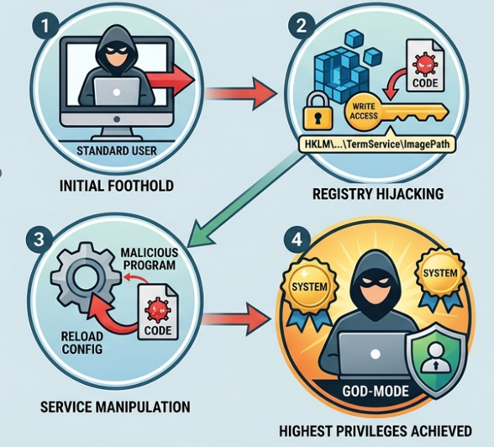
Windows Remote Desktop CVE-2026-21533
The vulnerability exploits the improper privilege management within the Remote Desktop Services, rated as a High Vulnerability with a CVSS score of 7.8.
The Mechanism: The flaw allows a locally authenticated attacker to manipulate a specific service/configuration, through a Remote Desktop session.
The Exploit: An attacker can replace a legitimate service with a malicious service/ configuration, such as evil twin, or establish a dormant connection on the host thereafter, the system would not properly validate, the permissions or the source of this modification and executes with the updated malicious configuration.
The Result: This exploit allows the attacker to escalate their privileges to SYSTEM/Root level, the highest level of administrative authority in Windows. Once privileges are escalated an attacker can perform any action, such as adding new users to an "Administrators" group, then installing persistent malware, or accessing and extracting sensitive data across the entire network.
Financial sectors in the South African use RDP with certain services, the following article is from ABSA bank.
https://cib.absa.africa/home/insights-and-events/remote-account-takeover/.
Notes:
Talking notes: CVE-2026-21533 is a critical Elevation of Privilege (EoP) vulnerability in Windows Remote Desktop Services (RDS). It was disclosed in February 2026 and was identified as being actively exploited in the wild as a "zero-day" before patches were available.
The Mechanism: The flaw allows a locally authenticated attacker (someone who already has a low-privilege account on the machine) to manipulate a specific service configuration registry key under the TermService (the service name for Remote Desktop).
The Exploit: An attacker can replace a legitimate service configuration key with a malicious, attacker-controlled key. Because the system does not properly validate the permissions or the source of this modification, the service executes with the updated (malicious) configuration.
The Result: This exploit allows the attacker to escalate their privileges to SYSTEM level—the highest level of administrative authority in Windows. Once privileges are escalated an attacker can perform any action, such as adding new users to the "Administrators" group, installing persistent malware, or accessing and extracting sensitive data across the entire network.

Slide 7
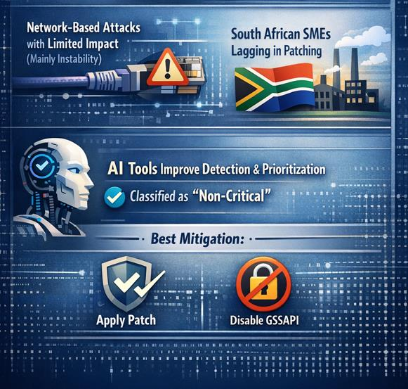
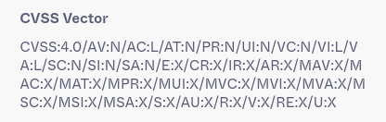
CVE-2026-3497 affects OpenSSH GSSAPI patches in Linux distributions like Ubuntu
The vulnerability is caused by improper error handling and uninitialised variables.
NVD rates it LOW (2.7), while Ubuntu rates it MEDIUM (6.9)
It allows network-based attacks but has a limited impact (mainly instability).
In South Africa, SMEs using Ubuntu are more exposed due to slower patching.
AI-based tools improve detection and prioritisation, but correctly classify this as non-critical.
The best mitigation is patching OpenSSH or disabling GSSAPI.
CVSS score is calculated using exploitability and impact metrics.
CVE-2026-3497 scores low because, although it is easy to exploit remotely, it causes only limited impact (no data breach or full system compromise).
Differences between NVD and Ubuntu scores occur because vendors consider real-world usage and operational risk.
The severity seems higher in South African SMEs environments where SSH stability is critical.
Notes:
NB: This infographic is to be done together on call when we ALL compile the presentation, ONE person is to generate the graphics, ensure to save the script from the AI version, date time etc….
Talking notes: CVE-2026-21533 is a critical Elevation of Privilege (EoP) vulnerability in Windows Remote Desktop Services (RDS). It was disclosed in February 2026 and was identified as being actively exploited in the wild as a "zero-day" before patches were available.
The Mechanism: The flaw allows a locally authenticated attacker (someone who already has a low-privilege account on the machine) to manipulate a specific service configuration registry key under the TermService (the service name for Remote Desktop).
The Exploit: An attacker can replace a legitimate service configuration key with a malicious, attacker-controlled key. Because the system does not properly validate the permissions or the source of this modification, the service executes with the updated (malicious) configuration.
The Result: This exploit allows the attacker to escalate their privileges to SYSTEM level—the highest level of administrative authority in Windows. Once privileges are escalated an attacker can perform any action, such as adding new users to the "Administrators" group, installing persistent malware, or accessing and extracting sensitive data across the entire network.

Slide 8


CVE-2025-48561 – Android Screen Data Theft Vulnerability
Flaw in the Android OS that makes it possible for malicious apps to capture screen data
without requiring added permissions.
Affected Products:
Nearly all modern Android device with versions 13 – 16+
Impact:
Capturing of Sensitive data
Banking Details
Company/Business Info.
OTPs and MFAs codes.
78.42% of South African use Android Based device (StatCounter Global Stats, 2025)
CVSS Score: 5.5 - Medium
Vector String: CVSS:3.1/AV:L/AC:L/PR:L/UI:N/S:U/C:H/I:N/A:N
Rating range (4.0 - 6.9) Indicates that the vulnerability is significant but not immediately critical. However, A moderate risk needs to be addressed in a specified amount of time approx. 30 - 90 days
Recommended Mitigation:
Avoid unauthorised APKs, Keeping Android OS updated
Notes:
NB: This infographic is to be done together on call when we ALL compile the presentation, ONE person is to generate the graphics, ensure to save the script from the AI version, date time etc….
Talking notes: CVE-2026-21533 is a critical Elevation of Privilege (EoP) vulnerability in Windows Remote Desktop Services (RDS). It was disclosed in February 2026 and was identified as being actively exploited in the wild as a "zero-day" before patches were available.
The Mechanism: The flaw allows a locally authenticated attacker (someone who already has a low-privilege account on the machine) to manipulate a specific service configuration registry key under the TermService (the service name for Remote Desktop).
The Exploit: An attacker can replace a legitimate service configuration key with a malicious, attacker-controlled key. Because the system does not properly validate the permissions or the source of this modification, the service executes with the updated (malicious) configuration.
The Result: This exploit allows the attacker to escalate their privileges to SYSTEM level—the highest level of administrative authority in Windows. Once privileges are escalated an attacker can perform any action, such as adding new users to the "Administrators" group, installing persistent malware, or accessing and extracting sensitive data across the entire network.

Slide 9

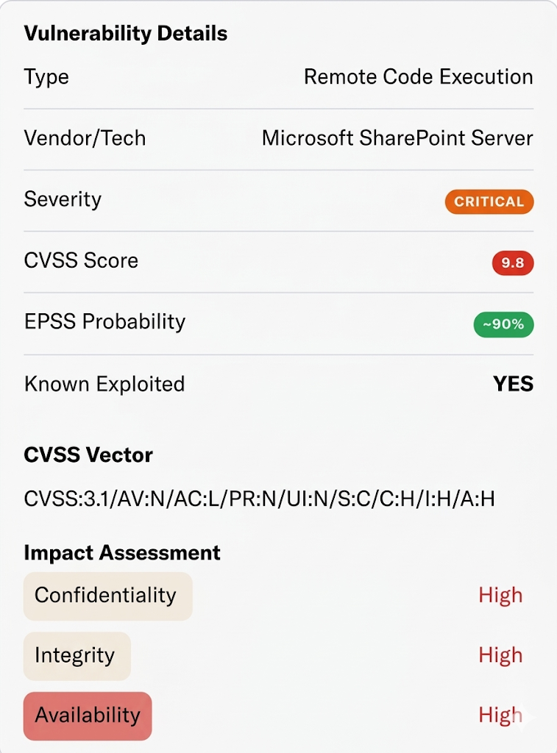
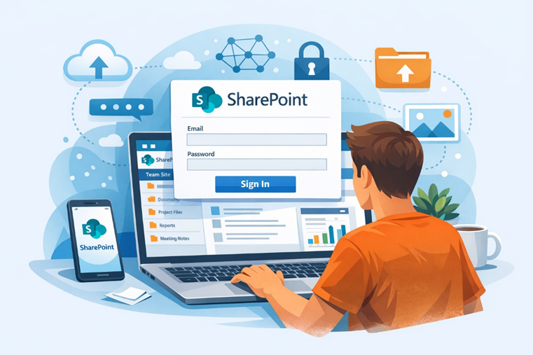
CVE-2026-20963: Enterprise Software Vulnerability - SharePoint RCE Vulnerability
CVE-2026-20963 is a high-risk remote code execution (RCE) flaw in Microsoft SharePoint Server, caused by unsafe data deserialization. With a CVSS score of 8.8, it poses a serious threat due to its ease of exploitation and potential business disruption.
​
Affected Products ​
MS SharePoint Server (Subscription Edition) - Versions before 16.0.19127.20442.
MS SharePoint Server 2019 - All unpatched deployments are affected.
MS SharePoint Server 2016 Enterprise Edition.
​
Discovery Timeline ​
CVE‑2026‑20963 was patched by Microsoft on January 13, 2026, but active exploitation was only publicly confirmed in March 2026.
Business Impact & Risk Analysis (in the South African context) :
Local municipalities in SA are still using SharePoint “on prem” for collaboration and information sharing, should this vulnerability be exploited it will have serious implications for these entities.
Immediate Actions ​
MS issued fixes in Jan 2026. All on‑prem servers should be updated without delay.
​
Workarounds ​
Threat Hunting: If patching is delayed, security teams should monitor for ” Indicators of Compromise" IoCs:
Suspicious Processes.
Web Shells: New or altered .aspx/.ashx files in SharePoint directories
Structural Defense (AI Tools) AI‑driven security can spot behavioural anomalies (e.g., unusual outbound connections) that signature‑based tools often miss.
Notes:
The Vulnerability: An RCE flaw allowing attackers to execute any command on your SharePoint server remotely via the internet.
Root Cause: Unsafe Deserialization - SharePoint can be tricked into converting malicious data into a live object, unintentionally executing hidden code. Even users with basic credentials — no admin rights — can trigger the exploit.
Full Server Compromise: Once executed, attackers inherit SharePoint Service Account rights, allowing them to read, modify, or delete any documents in the environment.
Lateral Movement: The compromised server acts as a pivot point, allowing attackers to move deeper into the internal network to target domain controllers or sensitive SQL databases.
Data Exfiltration: As SharePoint stores sensitive intellectual property and communications, attackers aim for large-scale data theft or ransomware deployment.
Business Impact & Risk Analysis (in the South African context) :
SharePoint is the "collaboration backbone" for many South African banks, legal firms, and government agencies, etc.
Corporate Espionage & Ransomware Target
Data Breach Risk: Exploiting this flaw lets attackers run code as the SharePoint Service Account, bypassing permissions to steal intellectual property or financial records.
Ransomware Gateway: In 2026, threat actors are using this RCE to launch ransomware. For South African businesses already under strain, recovery costs now average over R20 million.
2. Compliance and POPIA Liabilities
POPIA Compliance: Businesses must take “reasonable measures” to secure data. Ignoring a known, patched flaw could be seen as failing statutory obligations.
Mandatory Reporting: Exploitation would trigger notification to the Regulator and affected individuals, risking reputational damage and fines up to R10 million
3. The "Low-Privilege" Danger
The most dangerous aspect for SA firms is that Attackers often need only basic user access.
Phishing Risk: By stealing a junior employee’s credentials, they can exploit SharePoint with “Standard User” rights and escalate to full Domain Admin control.
Remediation & Defensive Strategy
1. Immediate Patching
Microsoft issued fixes in Jan 2026. All on‑prem servers should be updated without delay
2. Threat Hunting: If patching is delayed, security teams should monitor for ” Indicators of Compromise" IoCs:
Suspicious Processes: w3wp.exe spawning cmd.exe, powershell.exe, or unusual scripting engines.
Web Shells: New or altered .aspx/.ashx files in SharePoint directories
Structural Defense (AI Tools) AI‑driven security can spot behavioral anomalies (e.g., unusual outbound connections) that signature‑based tools often miss.

Slide 10
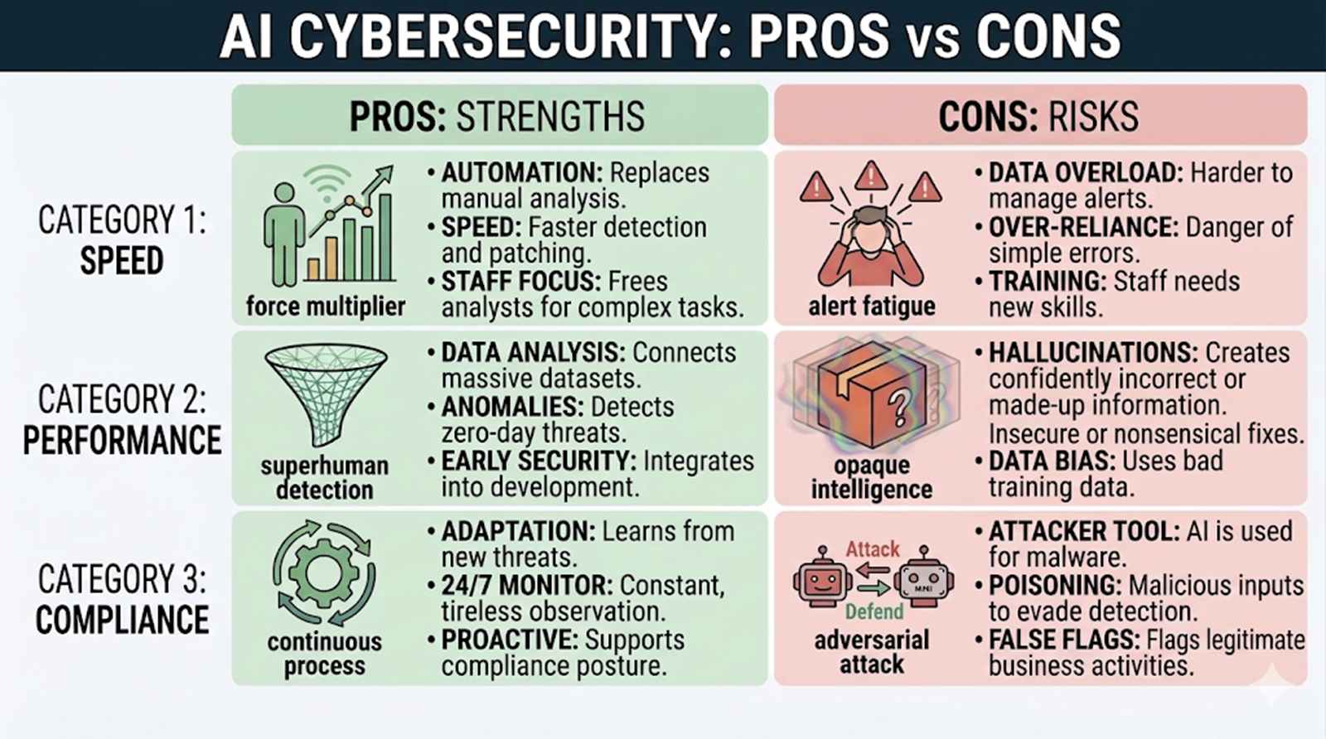
Considering AI Driven Security Tools
AI‑Driven Security Tools: Strategic Asset, Not a Silver Bullet:
AI tools offer major advantages such as, faster threat detection, predictive insights, and automated response, however they also bring challenges like false positives, high costs, and expanded attack surfaces.
Their real strength lies in a hybrid approach:
- Use AI for speed, scale, and pattern recognition.
- Rely on human expertise for context, judgment, and oversight.
Notes:
🌟 Potential Advantages
Early Detection of Vulnerabilities
AI can scan codebases and system behavior continuously, identifying flaws faster than manual reviews.
Machine learning models detect patterns of insecure coding practices and zero-day exploits.
Adaptive Threat Response
AI systems learn from new attack vectors and adjust defenses in real time.
Automated patching or containment reduces the window of exposure.
Reduced Human Workload
Security analysts are freed from repetitive tasks (log reviews, anomaly detection).
AI triages alerts, reducing false positives and focusing human effort on critical issues.
Scalability
AI tools can monitor vast, complex environments (cloud, IoT, enterprise networks) without proportional increases in staff.
Predictive Capabilities
By analyzing historical data, AI can forecast likely attack surfaces and prioritize remediation before exploitation occurs.
⚠️ Challenges
False Positives & Negatives
AI may misclassify benign behavior as malicious, overwhelming teams.
Conversely, novel exploits outside training data may slip through undetected.
Model Bias & Data Quality
AI effectiveness depends on the quality of training data. Poor or incomplete datasets can skew detection accuracy.
Complexity & Integration
Legacy systems may not integrate smoothly with AI-driven tools.
Skilled staff are required to interpret AI outputs and avoid blind reliance.
Adversarial Attacks
Attackers can deliberately manipulate inputs to mislead AI models (e.g., adversarial examples), creating new vulnerabilities.
Cost & Resource Requirements
Advanced AI tools require significant investment in infrastructure, licensing, and expertise.
🔎 Analysis: Mitigation vs Exacerbation
Mitigation Potential
AI tools excel at rapid detection and response, reducing the time attackers have to exploit vulnerabilities.
They can uncover hidden flaws in complex systems that human analysts might miss.
Predictive analytics help organizations patch proactively, lowering breach likelihood.
Exacerbation Risks
Over-reliance on AI without human oversight can create blind spots.
If attackers exploit weaknesses in the AI itself (e.g., poisoning training data), the tool may inadvertently open new attack vectors.
Misinterpretation of AI outputs could lead to delayed or incorrect remediation.
📌 Conclusion
AI-driven security tools are powerful allies in addressing software vulnerabilities, but they are not a silver bullet. Their effectiveness lies in a hybrid approach:
Use AI for speed, scale, and predictive insights.
Combine with human expertise for context, judgment, and oversight.
When balanced correctly, AI tools mitigate vulnerabilities more effectively than traditional methods. However, without governance and skilled interpretation, they risk exacerbating flaws by introducing new attack surfaces or misclassifications.

Slide 11

Software security recommendations
Software security has transformed from a discretionary technical implementation into a critical pillar of regulatory compliance and corporate governance.
Organisations now complement CVSS with additional metrics and systems, such as the Exploit Prediction Scoring System (EPSS) and Risk-Based Vulnerability Management (RBVM). EPSS predicts the likelihood of exploiting a vulnerability, while RBVM considers business impact, asset criticality, and existing security controls. Additional measures such as Continuous Monitoring, AI-assisted triage, AI-assisted Cross-referencing CVEs with the MITRE ATT&CK® framework links specific technical vulnerabilities to the adversary tactics and techniques they enable. This mapping transforms vulnerability management from a simple patching exercise into a threat-informed strategy, allowing organisations to prioritise vulnerabilities based on how attackers actually use them.
Compensating Controls:
Vulnerability & Patch Management
Automated Scanning:
Zero-Day Readiness:
Preventive Controls
Deploy from golden images across all workstations and servers
Antivirus
Identity and Access Management (IAM)
Privilege Access Management (PAM)
Zero-Trust Technologies
MFA & Push Notifications
Role-Based Access Control (RBAC)

Slide 12

Conclusion
CVSS Limitations
The Common Vulnerability Scoring System (CVSS) has several limitations that organisations need to consider:
Limited Context: CVSS scores do not account for the specific risks to your organisation. They tell you if a vulnerability is dangerous, but not if it is dangerous to you.
Subjectivity: CVSS scores can vary depending on the context, leading to inconsistencies.
Limited Scope: CVSS does not fully consider the importance of specific assets or existing controls.
Complexity: The system requires a deep understanding of scoring factors. Understanding how to calculate and interpret CVSS scores requires familiarity with several factors, such as attack vectors, complexity, and impact.
Potential for Oversights: Relying solely on CVSS scores can lead to missed opportunities to address the most pressing threats.
AI Driven Security Technology Considerations:
When balanced correctly, AI tools outperform traditional methods in mitigating vulnerabilities. But without governance and skilled interpretation, they risk misclassifying threats or introducing new vulnerabilities.
For South African organisations, this balance is critical to ensure compliance with POPIA and other regulatory frameworks.
Notes:
CVSS Limitations
The Common Vulnerability Scoring System (CVSS) has several limitations that organizations need to consider:
Limited Context: CVSS scores don’t account for the specific risks to your organization. They tell you if a vulnerability is dangerous, but not if it’s dangerous to you.
Example: Suppose two organizations—a financial institution and a small retail store—face the same vulnerability. CVSS might rate it as severe, but for the retailer, the risk might be minimal due to fewer sensitive assets, whereas for the financial institution, it could be critical due to the high value of their data.
Subjectivity: CVSS scores can vary depending on the context, leading to inconsistencies.
Example: A vulnerability in a widely used software might receive a high CVSS score based on its potential impact. However, the risk might be lower if a company has strong security operation controls. Yet, another organization with weaker controls might find the same vulnerability far more threatening, leading to different assessments.
Limited Scope: CVSS doesn’t fully consider the importance of specific assets or existing controls.
Example: CVSS might score a vulnerability in an out-of-date software as low because it’s not internet-facing. However, if that software version is critical to a company’s operations, the low score underestimates the risk, missing the asset’s importance.
Complexity: The system requires a deep understanding of scoring factors. Understanding how to calculate and interpret CVSS scores requires familiarity with several factors, such as attack vectors, complexity, and impact.
Example: This complexity can lead to misinterpretations or misuse of scores for organizations without dedicated security expertise.
Potential for Oversights: Relying solely on CVSS scores can lead to missed opportunities to address the most pressing threats.
Example: If an organization relies solely on CVSS scores, it might overlook threats that don’t score highly but are significant in their specific context—like vulnerabilities in internal systems that an insider could exploit.

Slide 13

Q & A
Notes:
CVSS Limitations
The Common Vulnerability Scoring System (CVSS) has several limitations that organizations need to consider:
Limited Context: CVSS scores don’t account for the specific risks to your organization. They tell you if a vulnerability is dangerous, but not if it’s dangerous to you.
Example: Suppose two organizations—a financial institution and a small retail store—face the same vulnerability. CVSS might rate it as severe, but for the retailer, the risk might be minimal due to fewer sensitive assets, whereas for the financial institution, it could be critical due to the high value of their data.
Subjectivity: CVSS scores can vary depending on the context, leading to inconsistencies.
Example: A vulnerability in a widely used software might receive a high CVSS score based on its potential impact. However, the risk might be lower if a company has strong security operation controls. Yet, another organization with weaker controls might find the same vulnerability far more threatening, leading to different assessments.
Limited Scope: CVSS doesn’t fully consider the importance of specific assets or existing controls.
Example: CVSS might score a vulnerability in an out-of-date software as low because it’s not internet-facing. However, if that software version is critical to a company’s operations, the low score underestimates the risk, missing the asset’s importance.
Complexity: The system requires a deep understanding of scoring factors. Understanding how to calculate and interpret CVSS scores requires familiarity with several factors, such as attack vectors, complexity, and impact.
Example: This complexity can lead to misinterpretations or misuse of scores for organizations without dedicated security expertise.
Potential for Oversights: Relying solely on CVSS scores can lead to missed opportunities to address the most pressing threats.
Example: If an organization relies solely on CVSS scores, it might overlook threats that don’t score highly but are significant in their specific context—like vulnerabilities in internal systems that an insider could exploit.

Slide 14
References
CVE. (n.d). Common Vulnerabilities and Exposures (CVE). https://www.cve.org/
National Institution of Standards and Technology. (n.d). National Vulnerability Database. https://nvd.nist.gov/
Tenable, Inc (n.d). Mitigate business-impacting cyber risk with Tenable One. https://www.tenable.com/
National Institute of Standards and Technology (2022) Guide to Enterprise Patch Management Planning: Preventive Maintenance for Technology. ??for enterprise?? https://doi.org/10.6028/NIST.SP.800-40r4
National Institute of Standards and Technology (n.d.). Computer security resource center (CSRC). https://csrc.nist.gov/
City St George University of London (n.d). https://technology.online.city.ac.uk/blogs/security-best-practices-in-software-development/
StatCounter. (n.d.). Mobile operating system market share in South Africa. https://gs.statcounter.com/os-market-share/mobile/south-africa
MITRE. (n.d.). MITRE ATT&CK. https://attack.mitre.org/

